Slide 1
OENG1118 Sustainable engineering practice and design
Week 1

Slide 2
Outline
Meet you instructors
Course content
Projects and assessment tasks
Groups

Slide 3
Meet your instructors

Slide 4
Peter Stasinopoulos
peter.stasinopoulos@rmit.edu.au, 57.03.36, City Campus
Qualification – BMechatronicEng(Hons), BMa&CompSCi, MEng, PhD
OENG1118 course convener and topic lecturer

Slide 5
Nirajan Shiwakoti
nirajan.shiwakoti@rmit.edu.au, 57.03.30, City Campus
Qualification – BCivEng(Hons), MEng(Hons), PhD, M.I.E.Aust.
OENG1118 topic lecturer
Program Manager BH076/092/100, Bachelor of Sustainable Systems Engineering

Slide 6
Course content

Slide 7
Course learning outcomes (CLOs)
Upon successful completion of this project-based learning course you should be able to:
selectively apply the fundamentals of sustainable engineering practice and design
selectively apply the fundamentals of life cycle sustainability assessments to engineering systems
develop and defend a strategy for sustainable engineering practice that accounts for ‘triple bottom line’ considerations.
Please see Part A and Part B for more detail

Slide 8
Course schedule
Wk 1. Introduction to OENG1118, Intro to sustainable development
Wk 2. (Public holiday)
Wk 3. Engineering design for sustainability
Wk 4. Engineering design for sustainability
Wk 5. Life cycle assessment – Goal and scope
Wk 6. Life cycle assessment – Inventory analysis
Wk 7. Life cycle assessment – Impact assessment
Wk 8. Life cycle assessment – Interpretation
Wk 9. Project Evaluation
Wk 10. Life cycle costing
Wk 11. Public consultation, Implementation, Societal impacts
Wk 12. Project assistance
A few key skills each week

Slide 9
Projects and assessment tasks

Slide 10
Assessment tasks
Wk 1. Introduction to OENG1118, Intro to sustainable development
Wk 2. (Public holiday)
Wk 3. Engineering design for sustainability
Wk 4. Engineering design for sustainability
Wk 5. Life cycle assessment – Goal and scope
Wk 6. Life cycle assessment – Inventory analysis
Wk 7. Life cycle assessment – Impact assessment
Wk 8. Life cycle assessment – Interpretation
Wk 9. Project Evaluation
Wk 10. Life cycle costing
Wk 11. Public consultation, Implementation, Societal impacts
Wk 12. Project assistance
A few key skills each week
Design
Deliverable
Test 1
Complete
Deliverable
Test 2

Slide 11
Assessment tasks
Week 1-2
Week 3 ________ ________ ________
Week 4 ________ ________ ________
… | …
Week 11 ________ ________ ________
Project
Project
Project-based learning
Lectures: learn fundamental content and skills
Private: apply content and skills to your group project
Tutorials: get feedback on your group project
Private: revise group project based on feedback
Project
Project

Slide 12
Assessment tasks
Group project – Overview
Group size: 4-6 students
Choose a product (or service) that comprises:
at least 3 major interacting subsystems
3-5 different major resource requirements (e.g., steel, concrete, water, electricity, diesel)
Examples: vehicles, buildings, whitegoods, municipal wastewater treatment processes, electronic devices
Overall tasks:
Redesign the product for better sustainability performance
Assess the sustainability performance of the product

Slide 13
Assessment tasks
Group project – Design Deliverable
Due: 11:30pm, Friday, March 26 via TurnItIn on Canvas>Assignments
Deliverable format: report
Deliverable size: 2000-2500 words (Executive summary–Conclusion)
Task:
Create a report that demonstrates the application of the Week 3-4 skills to your project group’s product. Ensure that the application of each skill is clearly communicated
Marks: 15%
Peer assessed using SparkPLUS (formative)

Slide 14
Assessment tasks
Group project – Complete Deliverable
Due: 11:30pm, Sunday, June 6 via TurnItIn on Canvas>Assignments
Deliverable format: report
Deliverable size: 4500-5000 words (Executive summary–Conclusion)
Task:
Create a report that demonstrates the application of the Week 3-11 skills to your project group’s product. Ensure that the application of each skill is clearly communicated.
Include a table of your responses to all feedback comments on your Design Deliverable.
Marks: 35%
Peer assessed using SparkPLUS (summative)

Slide 15
Assessment tasks
Individual quiz – Test 1
Due: 11:30pm, Sunday, May 2
Test size: 120 minutes
Test format: Multiple choice questions, long-answer questions, open book, calculators permitted
Task: Answer all test questions, which ask you to demonstrate the Week 5-8 skills
Marks: 25%

Slide 16
Assessment tasks
Individual quiz – Test 2
Due: 11:30pm, Sunday, May 30
Test size: 120 minutes
Test format: Multiple choice questions, long-answer questions, open book, calculators permitted
Task: Answer all test questions, which ask you to demonstrate the Week 9-11 skills
Marks: 25%

Slide 17
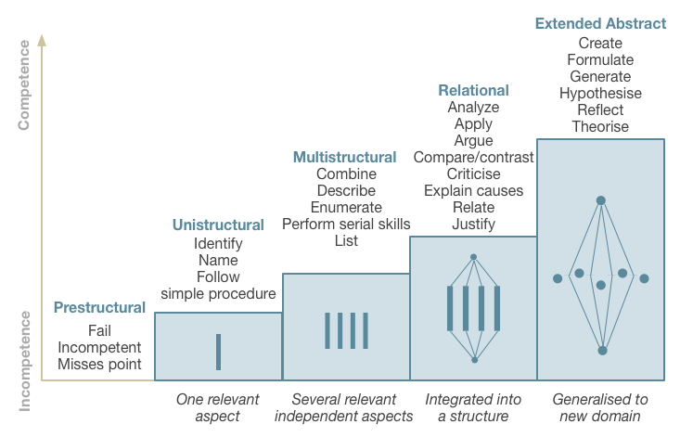
Assessment standards
SOLO taxonomy
Video (4 min)
Text (100 words)
Source: The Australian National University 2014, Unravelling Complexity, The Australian National University, Canberra. http://vc-courses.anu.edu.au/uc/home, viewed 4 March 2014.

Slide 18
Assessment standards
Plagiarism
Presentation of someone else’s work, idea, or creation, without appropriate referencing, as though it is your own. For example:
failure to properly document/reference a source
copying material from the Internet or databases
collusion between students
purchasing pre-written or on-demand papers
An offence to allow your work to be plagiarised. You are responsible for keeping your work secure
Canvas > Modules > Policies and Guidelines > Academic integrity policy
Canvas > Modules > RMIT Creds - Academic Integrity Awareness

Slide 19
Assessment standards
Report writing
Report writing guide
Library: (Australian) Harvard referencing guide
Learning Lab: Reports
Learning Lab: Writing skills
Learning Lab: Improve your English
Group work
Learning Lab: Group work
Canvas > Modules > Assessment resources

Slide 20
Groups
Break
Form project groups of 4-6 students
Group members may be from a mix of disciplines
Consider finding members in your study mode (face-to-face or online) or time zone
Register your group on Canvas > People > Project Groups

Slide 21
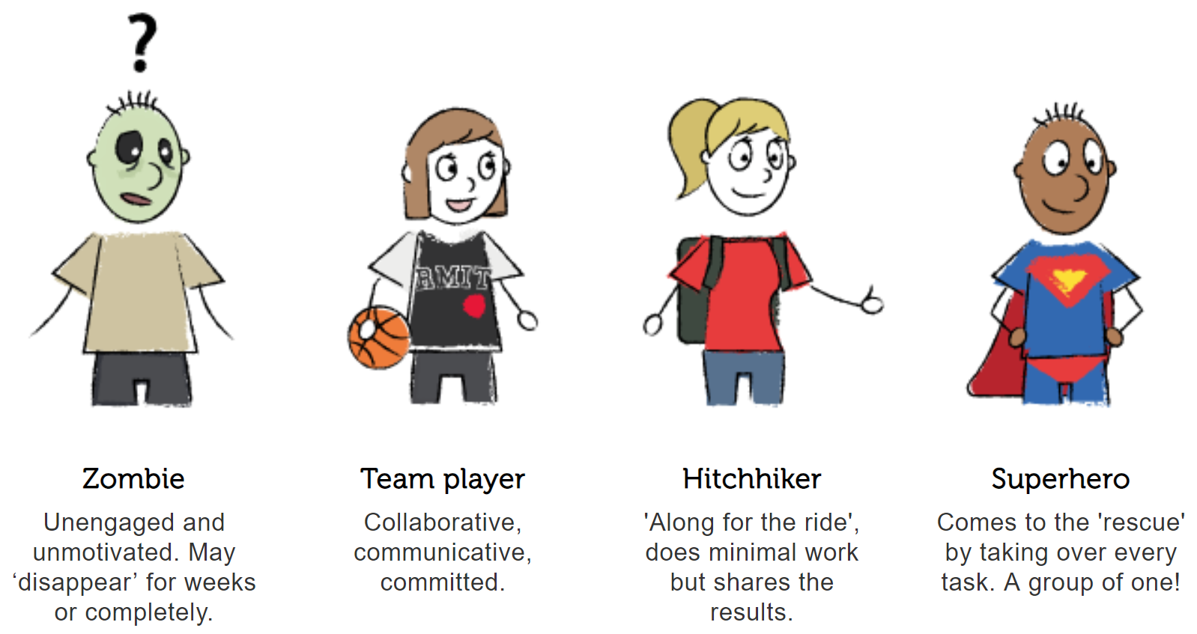
Groups
Activity
Clarify and document each groupmates’ aspirations, expectations, and preferences: (RMIT)
Availability to work on the project
Communication channel and response speed
Standard of draft work (to share with groupmates) and submitted work (to be compiled into submissions)
Conventions for developing and preparing artefacts
Grade
Etc.
Remember that each groupmate will be peer assessed using SparkPLUS
Notes:
In the past, many student groups adopted a variety of communication channels, the most popular combination being:
meet in person
chat online with a messenger app
leave, and respond to, notes in shared documents.

Slide 22
Groups
Activity
Develop a group contract:
Actions that each group member commits to doing/avoiding
What tasks will you do each week? When will you attend meetings? How will you treat group members? Etc.
Penalties for breaking the contract
How will you determine if the contract is broken? How will you enforce the penalties? Etc.
Process for making decisions
How will you communicate the options? Who is involved? Etc.
Process for resolving conflicts
How will you communicate the conflict? What makes the resolution fair? Etc.
Signatures

Slide 23
Thanks!

